Slide 1

SC4000
Machine Learning
Group Project
Brandon Jang Jin Tian (U2220936G), Chung Zhi Xuan (U2220300H), Ting Ruo Chee (U2220572C), Yau Jun Hao (U2220332F), Pearlina Tan Qinlin (U2221690F)
Notes:
Good afternooon Prof, we are group 1 and we will be presenting on our Machine Learning project.

Slide 2
Table of contents
01
02
03
04
05
Introduction
EDA
Feature Engineering
06
Model Fitting
Experimental Analysis
Conclusion
Notes:
This are the content we will be going through today!

Slide 3
Introduction
Predict Health Outcome of Horses
Notes:
The aim of this project is to provide a robust predictive model to predict the health outcome of horses in the kaggle competition.

Slide 4

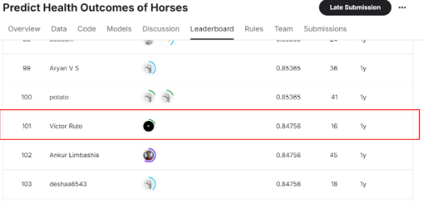
Evaluation Score
Rank = 101/1543 = 6.55% (Top 6%)
Notes:
We managed to achieve a score of 0.84756 which is top 6% in the ranking

Slide 5
02
EDA
Explore & Visualise Features
Notes:
Let's take a look at the insights from the EDA

Slide 6
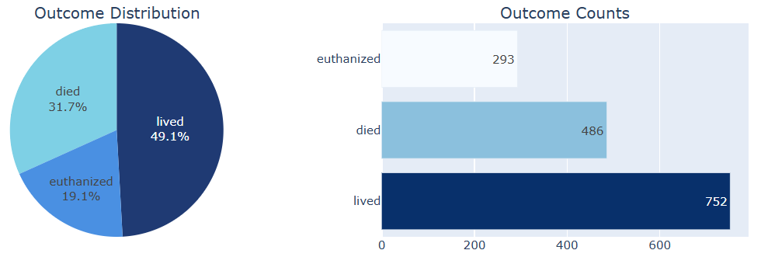
Target Variable Analysis
Imbalanced class with 50% of data in ‘lived’ class.
Notes:
The target variable has three classes, and there is an imbalance, with 50% of the data belonging to the 'lived' class

Slide 7
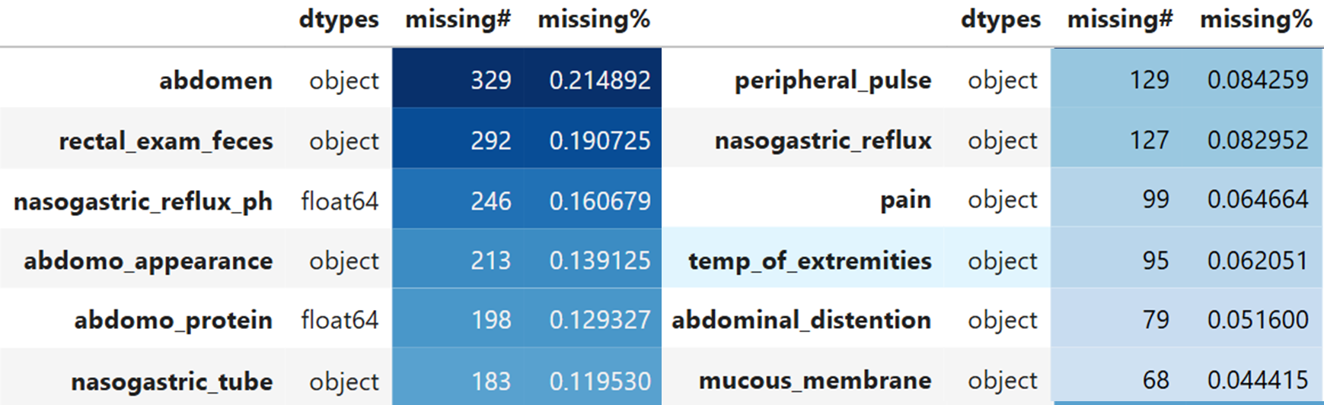
Missing Data Analysis
Both numeric and categorical variables contain missing value. Visualising each feature to determine strategies to impute missing values.
Notes:
Both the categorical and numeric variables contain missing values. Further analysis is needed to determine the best strategy for imputing these missing values

Slide 8
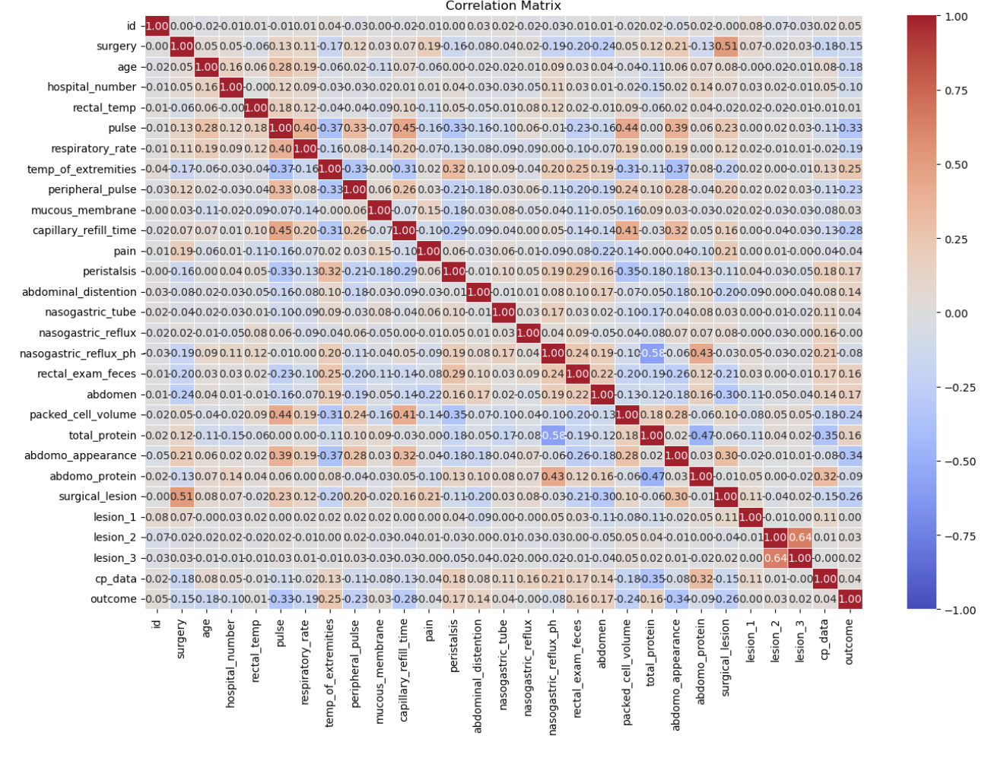
Correlation Matrix
From the correlation matrix, we can conclude that pain, rectal temperature, and surgical lesions emerge as strong predictors of health outcomes.
Notes:
We first analyse the dataset by plotting the correlation matrix. From the correlation matrix, we can conclude that pain, rectal temperature, and surgical lesions emerge as strong predictors of health outcomes.
There also seem to be moderate correlations between features like pulse and respiratory rate or total protein and packed cell volume suggest potential redundancies that can be addressed through feature engineering.
Lastly, weak correlations across many variables imply that the dataset likely benefits from including multiple independent features in the model to capture nuanced patterns.

Slide 9
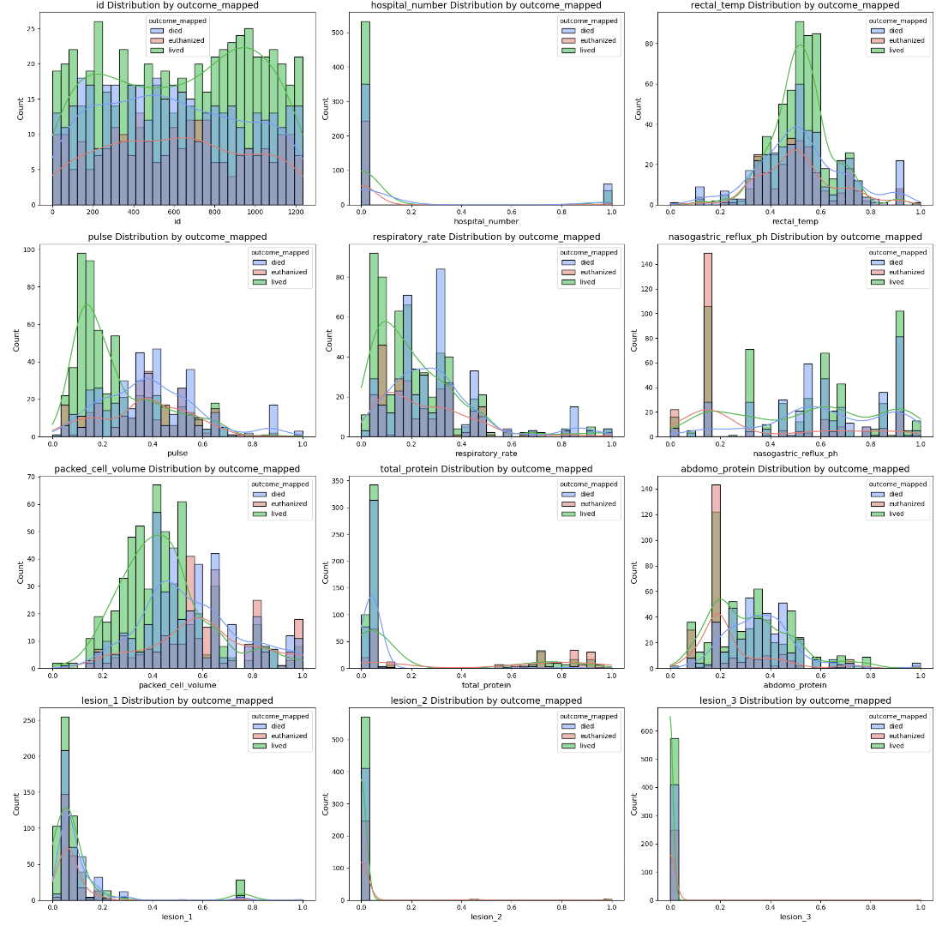
Numerical Variable Analysis
Variables like rectal_temp, pulse, respiratory_rate, packed_cell_volume, and abdomo_protein show meaningful differences among health outcomes, suggesting they could be strong predictors.
Notes:
We dive in further to the numerical variable analysis by plotting pair plots for each variable. We concluded that variables like rectal_temp, pulse, respiratory_rate, packed_cell_volume, and abdomo_protein show meaningful differences among health outcomes, suggesting that they could be strong predictors.

Slide 10
Numerical Variable Analysis
Some variables, such as hospital_number and id, do not appear to provide significant distinctions between the outcome groups and may not be useful for model training.
Notes:
Whereas some variables, such as hospital_number and id, do not appear to provide significant distinctions between the outcome groups and may not be useful for model training.

Slide 11
Numerical Variable Analysis
All three lesion variables show similar distributions, with most values being concentrated at low levels. There are no significant distinctions in outcomes, implying that lesion variables might have limited direct influence on prediction but could contribute when used with other variables.
Notes:
Lastly all three lesion variables show similar distributions, with most values being concentrated at low levels. There are no significant distinctions in outcomes, implying that lesion variables might have limited direct influence on prediction but could contribute when used with other variables.

Slide 12
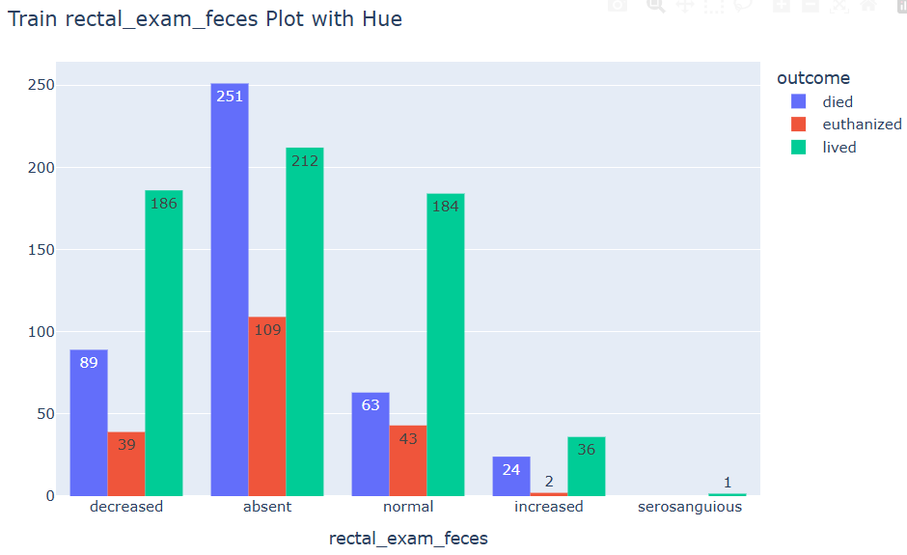
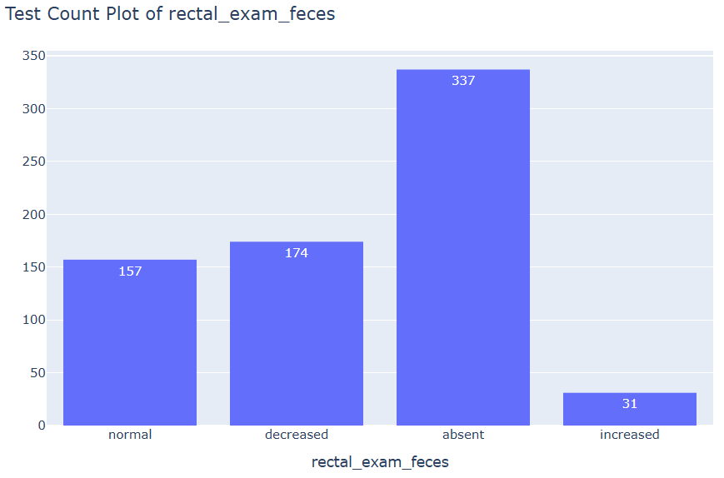
Categorical Variable Analysis
Extreme class appears only in train dataset for some of the categorical variable.
Class is imbalanced.
Notes:
Now, let's dive into the categorical variable. For the feature 'rectal exam feces', we observed an extreme class that appears only in the training data.

Slide 13
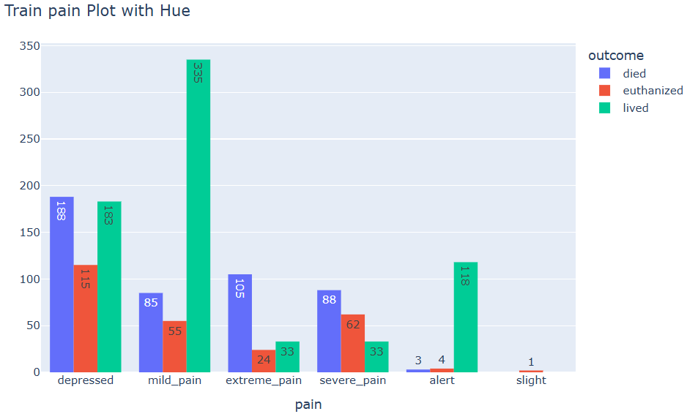
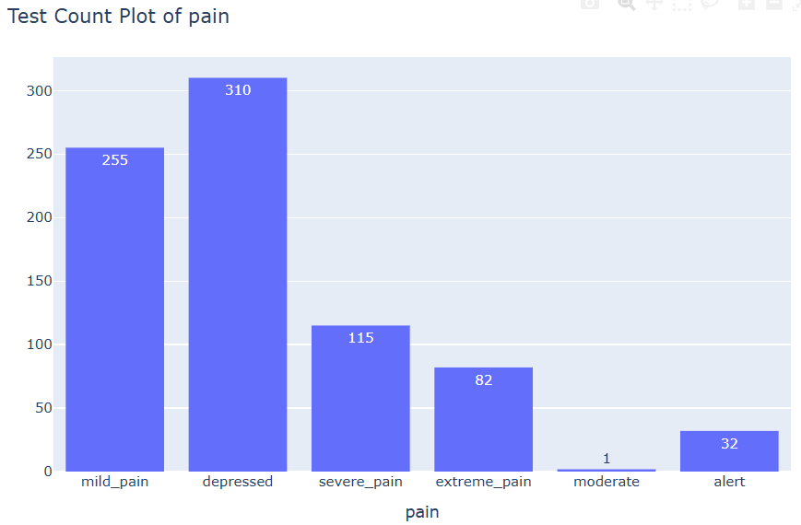
Categorical Variable Analysis
Some class are renamed to reduce the number of classes.
Notes:
For the feature 'pain', there were extreme classes with similar meanings but different names, which increased the difficulty of prediction. Therefore, we considered renaming them.

Slide 14
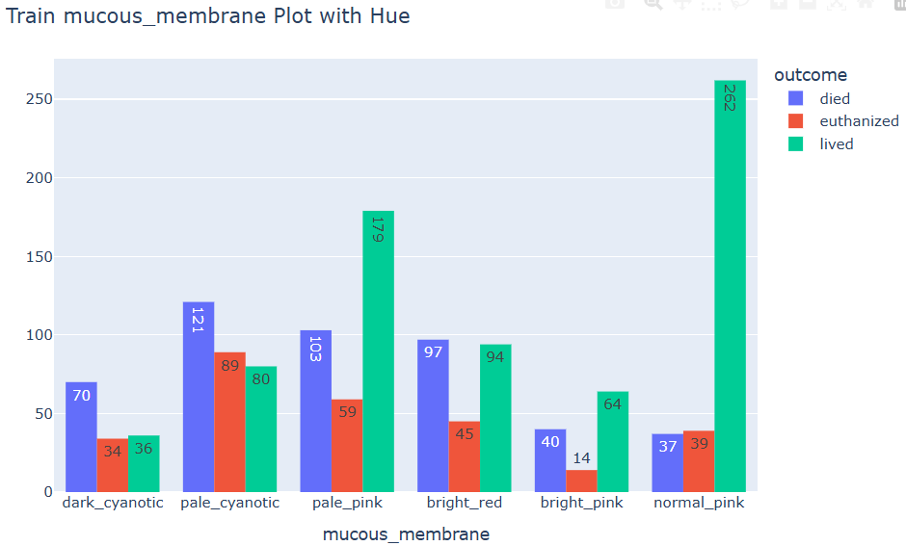
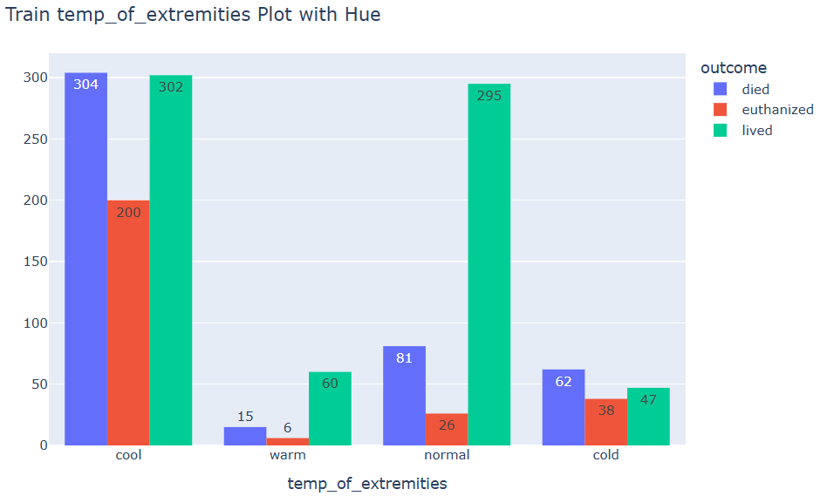
Categorical Variable Analysis
Features with no inherent order is encoded using one-hot encoder.
Ordinal features are to be encoded manually.
Notes:
For features that do not have an inherent order, we will use one-hot encoding. For features with an inherent order, we will encode them manually to preserve the sequence

Slide 15
03
Feature Engineering
Data Preprocessing
Notes:
After exploring the data, it's time to preprocess it and conduct feature engineering where necessary. We will start with the numerical data before moving onto categorical data.

Slide 16
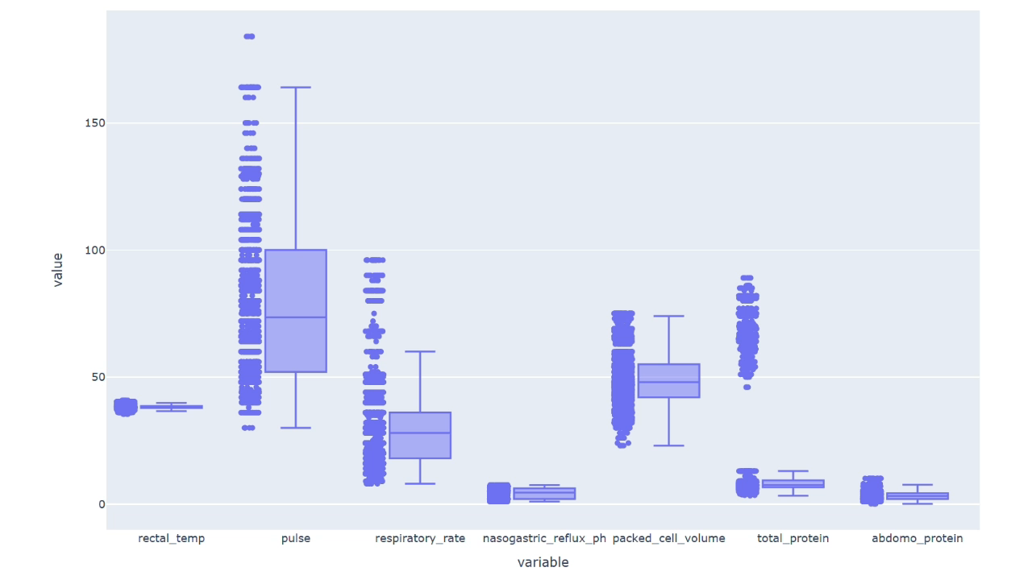
Numerical Data Preprocessing
Some variables appear to have a significant number of outliers.
Notes:
Firstly, we drew boxplots for the numerical variables to see if there are any outliers that require our attention. Indeed, there are two variables with many outliers which are respiratory_rate and total_protein.

Slide 17
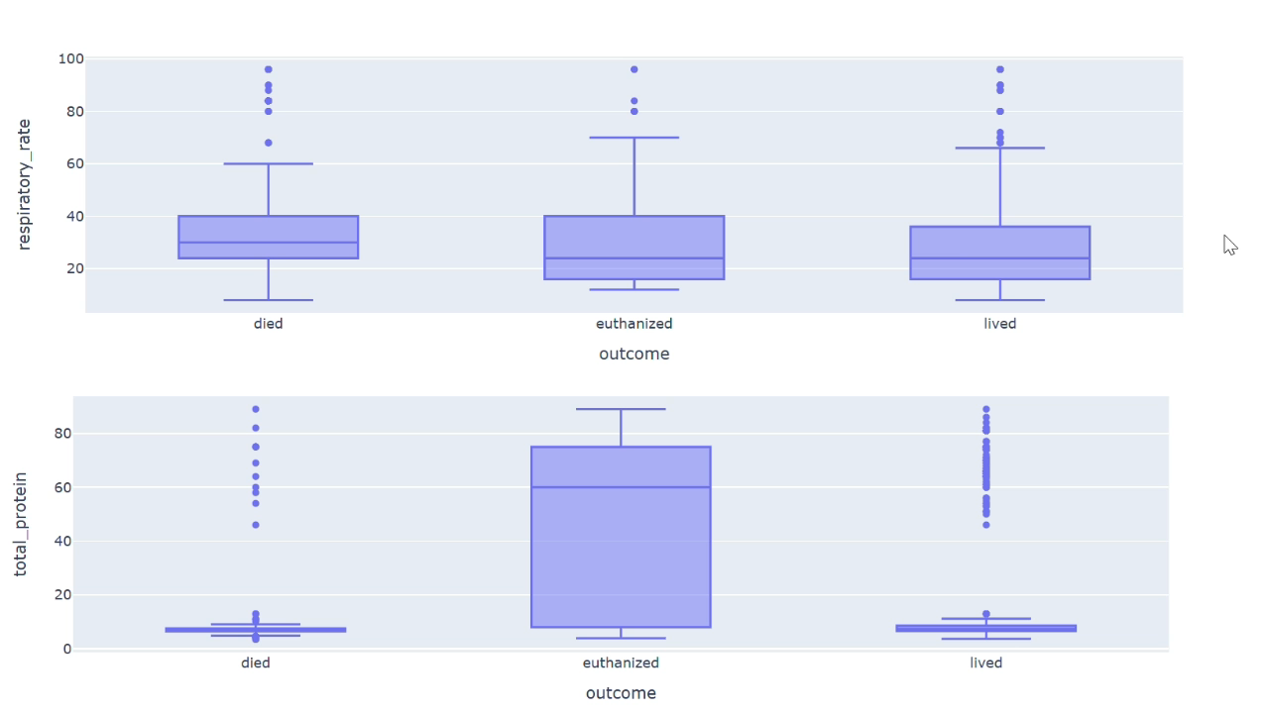
Numerical Data Preprocessing
Outliers are domain-relevant and provide valuable information; no data scaling or outlier removal conducted.
Notes:
However, we determined using domain knowledge that the outliers were not unusually high and in fact, the differences in distribution across different health outcomes suggest that these variables may be useful in predicting the target variable. Therefore, we did not conduct any scaling methods or outlier removal on the numerical data.

Slide 18
Categorical Data Preprocessing
temp_of_extremities
cold
cool
normal
warm
temp_of_extremities
0
1
2
3
Label encoding for ordinal variables to capture inherent hierarchy.
mucous_membrane
normal
pale_pink
dark_cyanotic
normal | pale_pink | dark_cyanotic
1 | 0 | 0
0 | 1 | 0
0 | 0 | 1
One-hot encoding for non-ordinal variables.
Notes:
For the categorical data, we conducted label encoding and one-hot encoding for ordinal and non-ordinal variables respectively. This helps machine learning models to capture the relationships within the data more accurately.

Slide 19
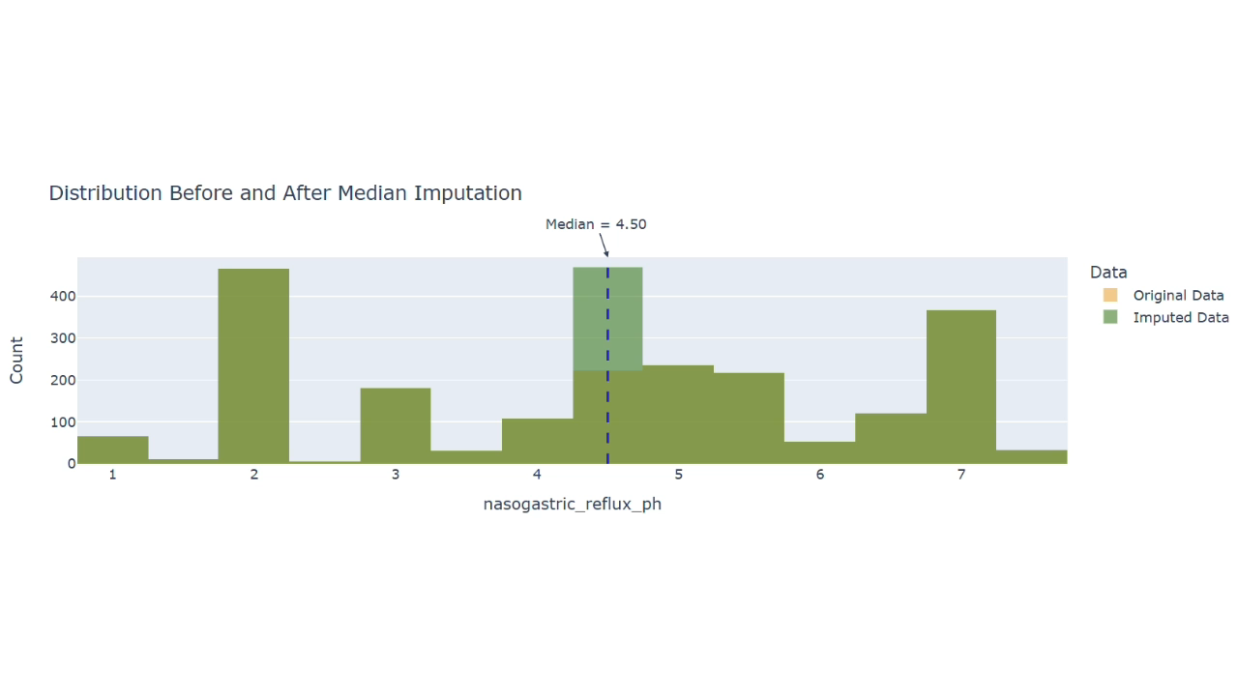
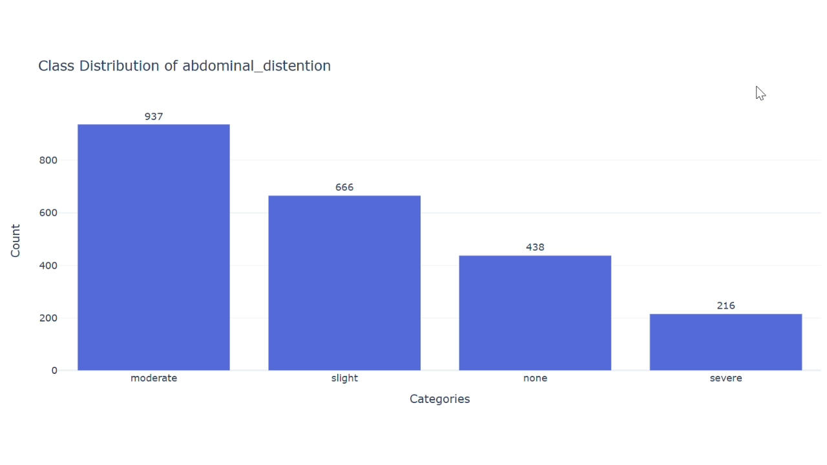
Null Value Imputation
Numerical variables are imputed with the median.
Categorical variables are imputed with the mode or domain-relevant default value.
Notes:
The next step of preprocessing was to impute null values. Numerical variables were imputed with the median to prevent skewing the distribution and categorical variables were either imputed with the mode or a more suitable default value. For example, it would make more sense to impute missing values in abdominal_distention with 'none' rather than the mode, 'moderate'.

Slide 20
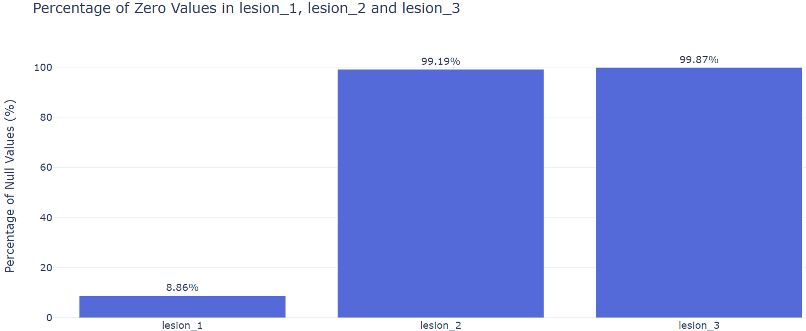
Columns Removed
Features containing more than 90% of zeroes are removed.
Notes:
Finally, we removed the columns lesion_2 and lesion_3 as they each contained more than 90% of zeroes, meaning no information was given and they would likely not be useful for model training.

Slide 21
04
Model Fitting
Attempted model

Slide 22
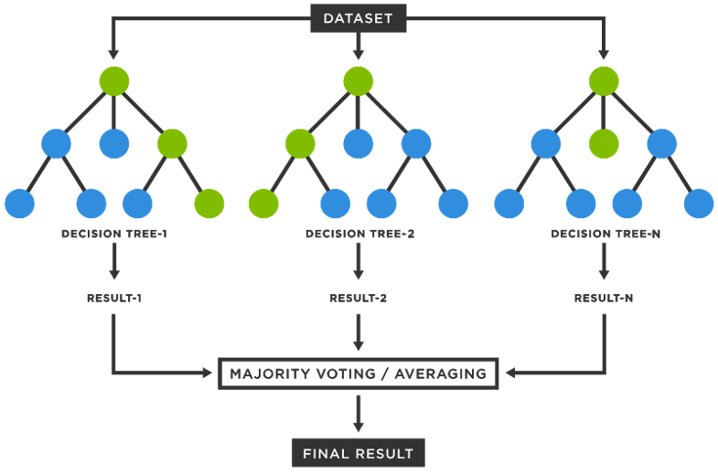
Random Forest Classifier
Random forest classifier combines multiple random generated decision trees for classifying target variable. Each tree is generated with a random subset of features and training data. The final outcome is obtained by majority voting among trees.
Notes:
The Random Forest classifier is an ensemble model that combines multiple decision trees, each trained on different subsets of the data and randomly selected features, to classify a target variable. The final prediction is typically made through majority voting among the trees.

Slide 23
Random Forest Classifier
Key Parameters Employed
n_estimators | The number of trees in the forest. | 300
max_features | The number of features to consider when looking for the best split. | sqrt
min_samples_leaf | The minimum number of samples per leaf. | 1
min_samples_split | The minimum number of samples required to split an internal node. | 10
max_depth | The maximum depth of each tree. | 100
4
Notes:
These hyperparameters were fined tuned to obtain the best prediction.

Slide 24
Random Forest Classifier
Ensemble Method
Combines predictions from multiple decision trees to make a final prediction which reduce overfitting.
Bootstrapping
Each tree is trained on a random subset of the training data, which introduce diversity to the model.
Random Feature Selection
Random subset of features are selected to reduce correlation among the trees.
Voting Mechanism
Aggregates the predictions of all the trees by majority voting, which leads to more stable and reliable predictions.
Notes:
Some key aspects of the model include the use of bootstrapping, where each tree is trained on different subsets of the data, introducing diversity into the model.
The random selection of features helps reduce correlation among the trees.
The prediction is more reliable because it is obtained through majority voting.

Slide 25
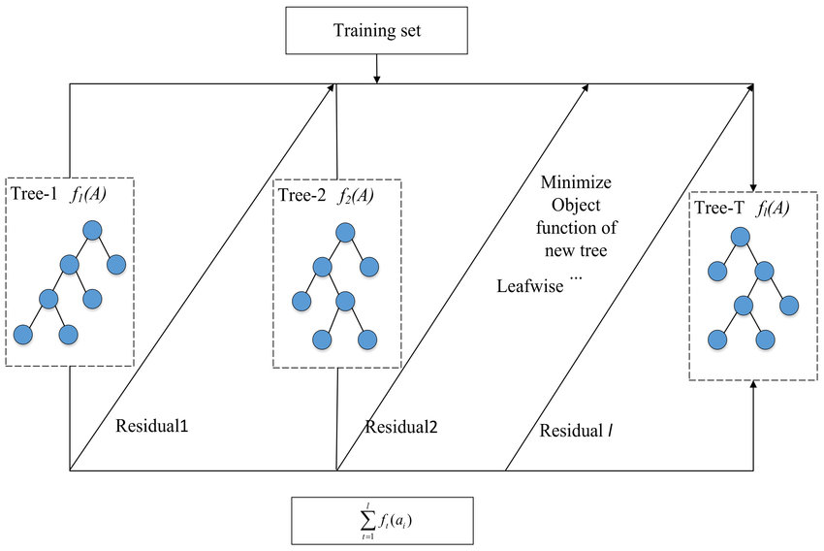


Light Gradient-Boosting Machine (LightGBM)
Highly Efficient
Fast Implementation
Characteristics of LightGBM
Handles Class Imbalance
via parameters like scale_pos_weight or through techniques like SMOTE
Leaf-Wise Growth
continues to grow deeper on most promising branches of the tree where improvements in accuracy are made
(LightGBM Model Computing Process., 2024)
LightGBM is a highly efficient and fast implementation of gradient boosting for decision tree algorithms where it is designed for performance and speed in handling large datasets (Ke et al., 2017).
Handles Class Imbalance: LightGBM can internally handle class imbalance via parameters like scale_pos_weight or through techniques like SMOTE as applied before. By training on the SMOTE-augmented data, your LightGBM classifier ensures that minority classes (died, euthanized) are considered more heavily during model training, improving the ability to classify them correctly.
Leaf-Wise Growth: LightGBM grows trees leaf-wise instead of level-wise. This means that it will continue to grow deeper on the most promising branches (leaves) of the tree, where more improvements in prediction accuracy can be made.
Notes:
LightGBM is a fast and highly efficient implementation of gradient boosting, optimized for performance with large datasets.
LightGBM can manage class imbalance through parameters like scale_pos_weight or by training on SMOTE-augmented data. This approach allows LightGBM to give more attention to minority classes (such as 'died' and 'euthanized'), enhancing its ability to classify these cases accurately.
Unlike traditional level-wise growth, LightGBM grows trees leaf-wise, expanding the most promising branches where prediction accuracy can improve significantly. This strategy allows LightGBM to achieve greater accuracy with fewer trees.

Slide 26
Light Gradient-Boosting Machine (LightGBM)
Key Parameters Employed
max_depth | Controls the depth of each tree to avoid overfitting. | 6
min_child_samples | Minimum number of data points a node should have before splitting. | 10
n_estimators | The number of trees to build. | 200
learning_rate | Controls how much to shrink the contribution of each tree. | 0.05
4
Notes:
Here are some key parameters we use for baseline review

Slide 27
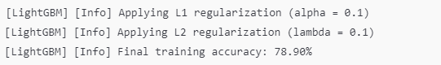
Light Gradient-Boosting Machine (LightGBM)
1
2
3
Gradient-Based Learning
Regularisation
Prediction
For each boosting round, our model tries to reduce the residual error from previous trees, optimising the performance of the model.
LightGBM has built-in L1 and L2 regularisation to prevent overfitting by penalising the size of the model.
Our LightGBM model uses the ensemble of decision trees to make predictions on new, unseen data. It uses the cumulative votes from all the trees to predict the class.
4
Notes:
LightGBM builds each tree by focusing on the residual errors of previous trees. In each boosting round, the model attempts to correct these errors, progressively improving its performance with each iteration.
LightGBM includes built-in L1 (reg_alpha) and L2 (reg_lambda) regularization to prevent overfitting. These techniques penalize model complexity, helping ensure the model generalizes well to new data.
Once trained, LightGBM uses the ensemble of decision trees to make predictions on new data. It aggregates votes across all trees to predict the final class, enhancing accuracy through the cumulative insights of each tree.

Slide 28
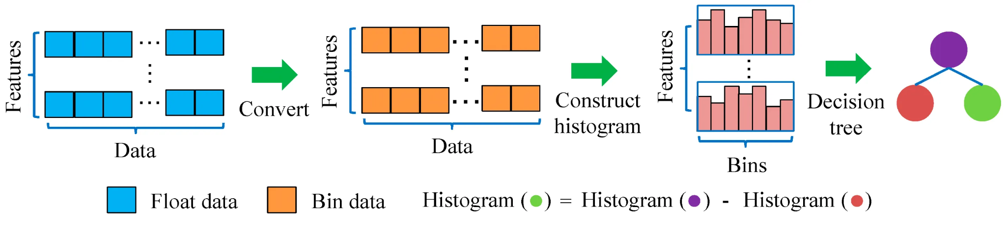
Histogram-Based Gradient-Boosting (HistBoost)
(Liang et al., 2020)
An optimized version of Gradient Boosting, designed for faster performance and better efficiency on large datasets.
Instead of evaluating each feature value, it bins continuous features into discrete histograms.
Notes:
Next, we will talk about HistGradient Boosting, which is an optimized version of Gradient Boosting designed for faster computation and better efficiency, especially on large datasets. Instead of evaluating every feature value, it bins continuous features into discrete intervals, reducing the number of split points the model considers. This approach minimizes memory usage and speeds up training, making it ideal for handling high-dimensional data efficiently.

Slide 29
Histogram-Based Gradient-Boosting (HistBoost)
Key Parameters Employed
l2_regularization | The L2 regularisation parameter penalises leaves with small hessians. | 0.5247
learning_rate | The learning rate, also known as shrinkage. | 0.0705
max_bins | The maximum number of bins to use for non-missing values. | 10
max_depth | The maximum depth of each tree. | 5
max_iter | The maximum number of iterations of the boosting process, i.e. the maximum number of trees for binary classification. | 100
max_leaf_nodes | The maximum number of leaves for each tree. | 21
min_samples_leaf | The minimum number of samples per leaf. | 2
Parameter Tuning with Randomized Search
Used randomized search to efficiently explore the hyperparameter space and identify optimal settings.
Notes:
These are the optimal parameters obtained through randomized search.

Slide 30
Histogram-Based Gradient-Boosting (HistBoost)
Gradient-Based Optimization
Similar to other gradient boosting, each tree corrects the errors of the previous ones, improving predictions with each iteration.
Binning of Features
Continuous features are divided into discrete bins (histograms), reducing split evaluations and enhancing speed.
Memory Efficient
Uses less memory by working with binned data, which is smaller and more manageable.
Regularization
Supports L2 regularization to control model complexity, plus parameters like max_depth and learning_rate to avoid overfitting.
Notes:
The key features of HistBoost is gradient-based optimization, the binning of features, regularization technique and its memory efficiency.
The gradient-based optimization is similar to other gradient boosting methods where each tree corrects the errors of the previous ones thus improving predictions with each iteration.
The most unique feature is its use of feature binning. Rather than evaluating every continuous feature value, HistBoost divides features into discrete bins or histograms. This not only speeds up computation by reducing the number of split points but also makes the algorithm more efficient with memory.
Lastly, it supports L2 regularization and parameters like max_depth and learning_rate to prevent overfitting, making it highly effective for large datasets.

Slide 31
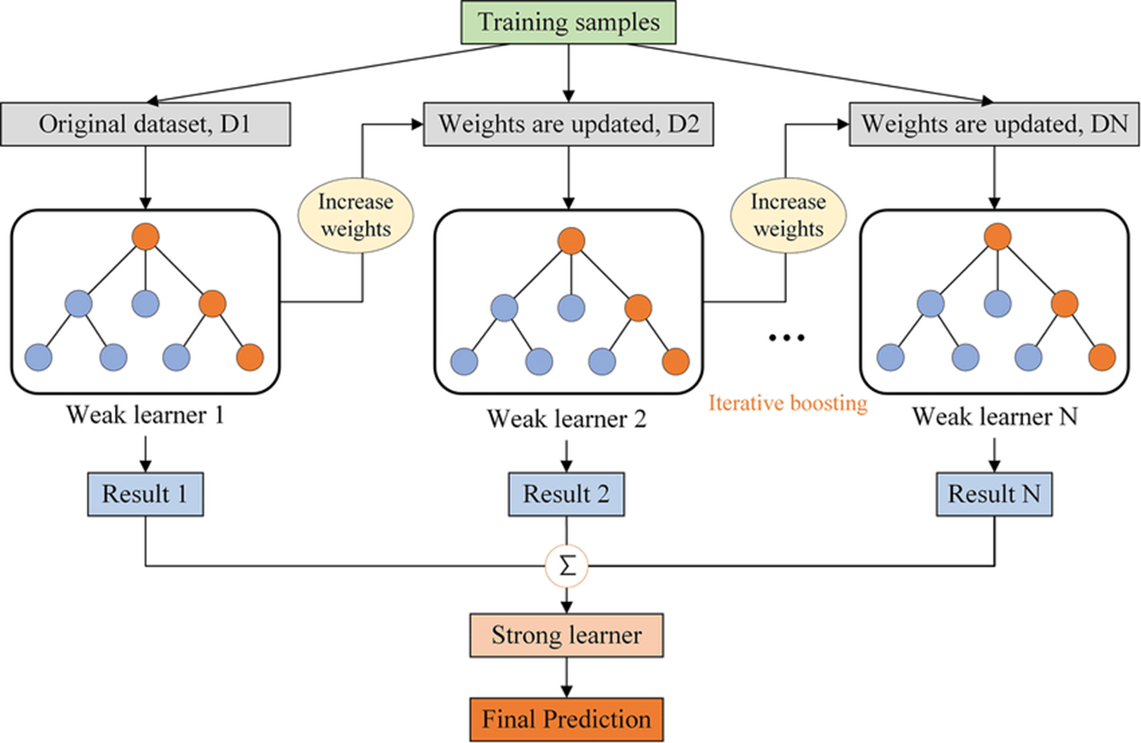
Extreme Gradient-Boosting (XGBoost)
XGBoost builds an ensemble of decision trees sequentially, where each new tree corrects the errors made by the previous trees.
Notes:
We further experiment XGBoost where it builds an ensemble of decision trees sequentially, where each new tree corrects the errors made by the previous trees. Unlike simple models that fit the data once, XGBoost iteratively improves its predictions by minimizing a specified loss function through gradient descent. This approach makes it robust for complex datasets and ideal for large-scale data tasks.

Slide 32
Extreme Gradient-Boosting (XGBoost)
Key Parameters Employed
n_estimators | The number of boosting rounds or trees. | 500
max_depth | Controls the maximum depth of each decision tree, preventing overfitting. | 6
learning_rate | The step size at each iteration while moving toward a minimum of the loss function. | 0.1
gamma | The minimum loss reduction required for a split to be made. | 0.2
colsample_bytree | Controls the fraction of features used to grow each tree. | 0.8
subsample | The fraction of the training set used to fit each tree to control overfitting. | 0.9
reg_lambda (L2 regularisation) | Prevents overfitting by penalising large coefficients. | 1
Notes:
These are the optimal parameters we used for the XGBoost model.

Slide 33
Extreme Gradient-Boosting (XGBoost)
Gradient-Based Optimization
XGBoost uses gradient boosting, where each new tree corrects errors made by previous trees, which improves predictions over iterations.
L2 regularization control the complexity of the model. Gamma prevents unnecessary split. Max_depth and subsample helps to controlling tree growth and introduce randomness.
Regularization
Parallelized Execution
XGBoost supports parallel processing, speeding up tree construction.
Built-In Cross - Validation
XGBoost provides methods for cross-validation, which can help improve model performance during training.
Notes:
Here are some key pointers, XGBoost uses gradient boosting whereby it is designed to optimize model performance by sequentially improving upon previous rounds which is accurate and efficient in handling structured data. We also implemented L2 regularisation to control the complexity of the model, and gamma to prevent uncessary split. Whereas, max_depth and subsample helps to control tree growth and introduce randomness. This help to ensure that the model generalizes well to unseen data, making it less likely to overfit. XGBoost also supports parellel processing, which speeds up tree constuction. Lastly, XGboost have built-in cross validation which can help improve model performance during training.

Slide 34
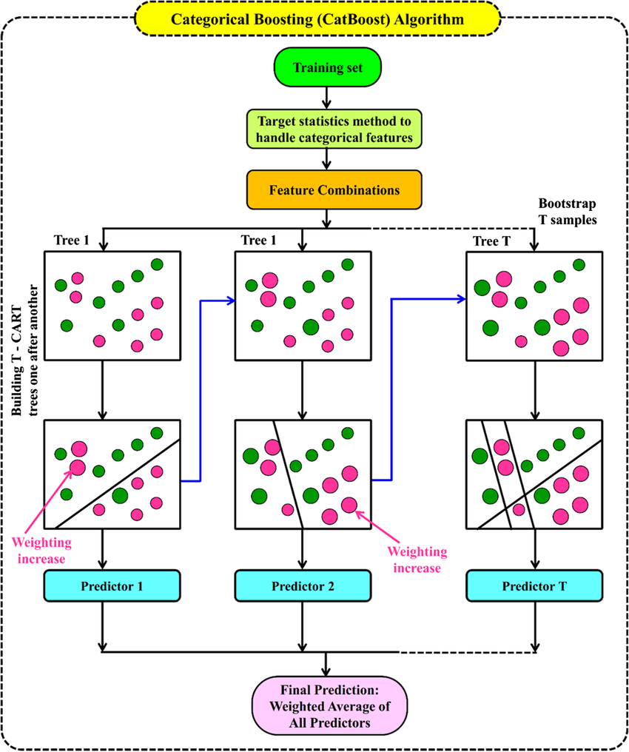
Categorical Boosting (CatBoost)
CatBoost is a gradient boosting algorithm designed to handle categorical features directly without the need for explicit encoding.
Constructs models by adding decision trees that correct previous errors and gradually builds an ensemble to minimize prediction errors.
It is known for its ability to handle high-cardinality categorical variables efficiently and to prevent overfitting.
Pandey, Manish & Karbasi, Masoud & Jamei, Mehdi & Malik, Anurag & Pu, Jaan H. (2023)
Notes:
Next up is CatBoost, which is a gradient boosting algorithm designed to handle categorical features directly, eliminating the need for explicit encoding in the data preparation process.
It constructs models incrementally by adding decision trees that correct the errors made by previous trees. This gradual process allows it to build an ensemble that effectively minimizes prediction errors.
One of CatBoost's key strengths is its efficiency in managing high-cardinality categorical variables, making it particularly suitable for datasets with many unique categories. Additionally, it incorporates techniques to prevent overfitting, ensuring reliable predictions on unseen data.

Slide 35
Categorical Boosting (CatBoost)
Key Parameters Employed
cat_features | The list of indices of categorical features, allowing the model to handle them appropriately. | -
iterations | The maximum number of trees to build in the boosting process. | 500
learning_rate | The step size at each iteration while moving toward a minimum of the loss function. | 0.0936
bagging_temperature | Controls the strength of bagging, a technique where random subsets of data are used for training the model. | 0.8116
l2_leaf_reg | The L2 regularisation coefficient to reduce overfitting by penalising large weights. | 4.5594
random_strength | The strength of randomness when choosing splits. | 7
border_count | The maximum number of borders used to split continuous features into discrete bins. | 50
depth | The depth of the trees; deeper trees can model more complex relationships but may lead to overfitting. | 5
Notes:
The optimal parameters obtained through randomized search are shown here.

Slide 36
Categorical Boosting (CatBoost)
Efficient Categorical Handling
Automatically processes categorical variables without one-hot encoding or label encoding, saving memory and improving accuracy.
Ordered Boosting
Reduces prediction bias by utilizing a unique boosting technique that respects the order of data.
Builds balanced trees where all leaf nodes at the same level share the same decision rule, enhancing execution speed and prevent overfitting.
Symmetric Trees
Regularization
Utilizes L2 regularization on leaf values to limit excessive values and reduce overfitting.
Notes:
The key feature of CatBoost is that it is designed for efficient handling of categorical data without needing one-hot or label encoding. This saves memory and enhances accuracy, especially with high-cardinality features.
CatBoost also uses Ordered Boosting, which respects data order to reduce bias in predictions.
Additionally, CatBoost builds Symmetric Trees, where all leaf nodes at each level share the same rule, speeding up execution and reducing overfitting.
For regularization, CatBoost uses L2 regularization on leaf values to prevent overfitting and improve model generalization.

Slide 37
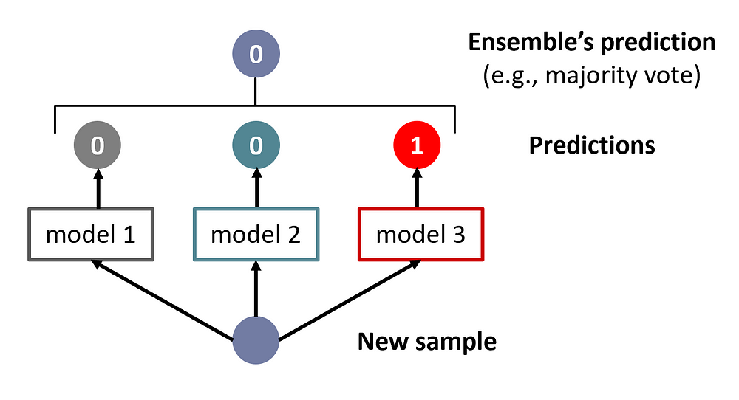
Ensemble Learning
What are Ensemble Methods?
Combines multiple models to improve predictive accuracy.
Reduces variance and bias by leveraging model strengths.
Key Aggregation Techniques:
Max Voting: Chooses the class label with the most votes.
Averaging: Averages predictions from each model.
Weighted Averaging: Assigns weights to each model’s predictions based on performance.
Notes:
Finally, we tried using ensemble methods to combine multiple models to boost predictive accuracy. This utilizes the strengths of each model to reduce both variance and bias in predictions.
There are a few key techniques for aggregating these models:
First, Max Voting, which it picks the class label with the most votes across models.
Next, Averaging which it simply averages each model’s predictions.
And finally, Weighted Averaging which assigns weights to models based on their performance, allowing stronger models to have more influence on the final prediction.

Slide 38
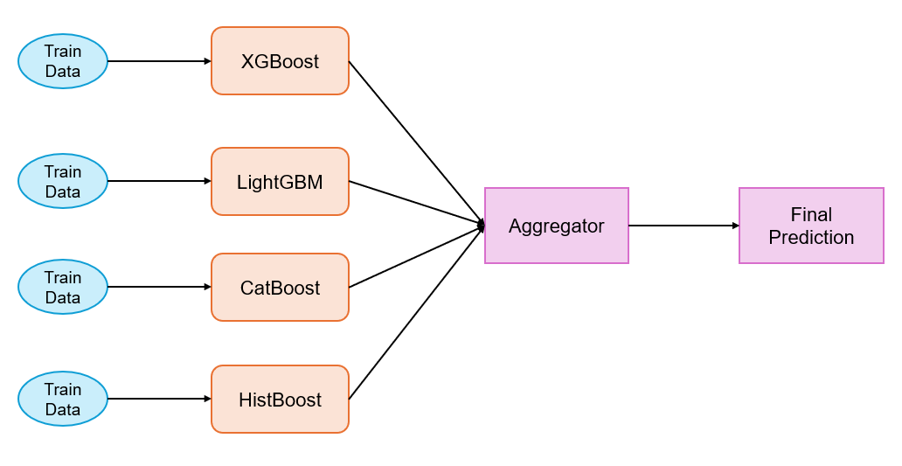
Ensemble Learning
Our Approach:
Experimented with Weighted Averaging to combine multiple gradient boosting models.
Models used: XGBoost, LightGBM, CatBoost, HistBoost
Example Illustration of Our Approach
Notes:
In our approach, we used Weighted Averaging to combine predictions from multiple gradient boosting models. This method allows us to assign different levels of importance to each model based on its performance.
The models we used for this ensemble were XGBoost, LightGBM, CatBoost, and HistBoost. By combining these models, we aim to leverage their individual strengths for a more accurate and robust final prediction.

Slide 39
Ensemble Learning
Experiments and Optimization Process
Tuned models using Randomized Search on accuracy scores from cross-validation.
Used Optuna’s OptunaWeights Class to find optimal weights for each model.
Performance metric: F1 Micro Score on validation set.
Out-of-Fold Predictions: Stored for each fold to refine weight distribution.
Example Illustration of Our Approach
Notes:
In our experiments, we tuned each model using Randomized Search to maximize accuracy based on cross-validation results. We then used Optuna’s OptunaWeights Class to identify the optimal weights for each model in the ensemble.
Our performance metric was the F1 Micro Score which is evaluated on the validation set. Additionally, we stored Out-of-Fold Predictions for each fold, helping to refine the weight distribution across models.

Slide 40
Ensemble Learning
Weight Distribution of Each Model
Combination | Models | Weights | Accuracy
1 | XGBoost | 0.34035 | 0.78048
 | LightGBM | 0.22045
 | CatBoost | 0.22459
 | HistBoost | 0.21461
2 | XGBoost | 0.28588 | 0.79268
 | XGBoost (tuned) | 0.17707
 | LightGBM | 0.29040
 | CatBoost | 0.24664
Note: In combination 2, two XGBoost models with different hyperparameters were used.
Notes:
In this table, the optimal weights for each model is shown.

Slide 41
05
Experimental Analysis

Slide 42
Experimental Analysis of Chosen Solution
LightGBM
Key Parameters Employed for Hyperparameter Tuning
Parameters | n_estimators | [100, 200, 300]
 | max_depth | [4, 6, 8, 10]
 | learning_rate | [0.01, 0.05, 0.1]
 | subsample | [0.6, 0.8, 1.0]
 | colsample_bytree | [0.6, 0.8, 1.0]
 | min_child_samples | [10, 20, 30]
 | reg_alpha | [0, 0.1, 0.5]
 | reg_lambda | [0, 0.1, 0.5]
4
Notes:
We have chosen LightGBM as part of our experimental analysis as it yields one of the highest validation accuracy and micro-averaged F1-score. For further experiment on the hyperparameter tuning, these are the parameters we choose to tune to find the optimal parameters to yield the highest validation accuracy

Slide 43
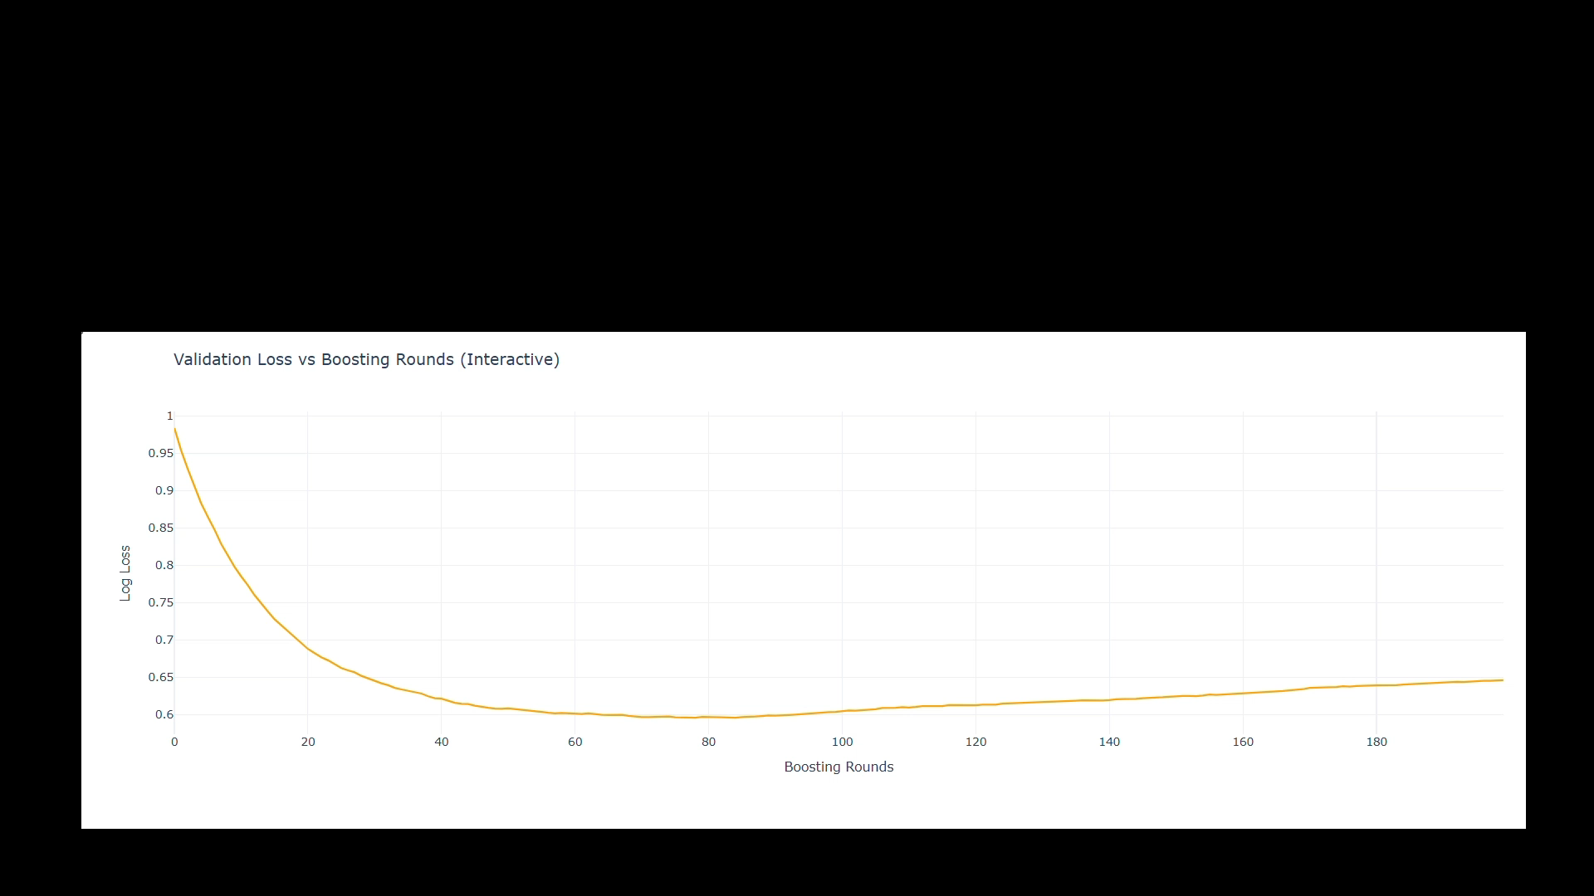
Validation vs Boosting Rounds
Validation loss decreases steeply during the first 20-40 boosting rounds
After about 120 boosting rounds, validation loss starts to increase
4
Notes:
During training, we observed a sharp decrease in validation log loss over the first 20–40 boosting rounds. This decline slows down and stabilizes around 100 rounds, indicating a potential sweet spot for model performance. However, after approximately 120 boosting rounds, the log loss begins to rise again, suggesting that the model may be overfitting beyond this point. The final log loss stabilizes at around 0.6, but the slight increase after 100 rounds indicates the model could have benefitted from early stopping. To address this, we could introduce an early stopping mechanism, setting a stopping threshold at around 100 rounds. This adjustment could prevent overfitting and further enhance the model’s generalization ability.

Slide 44
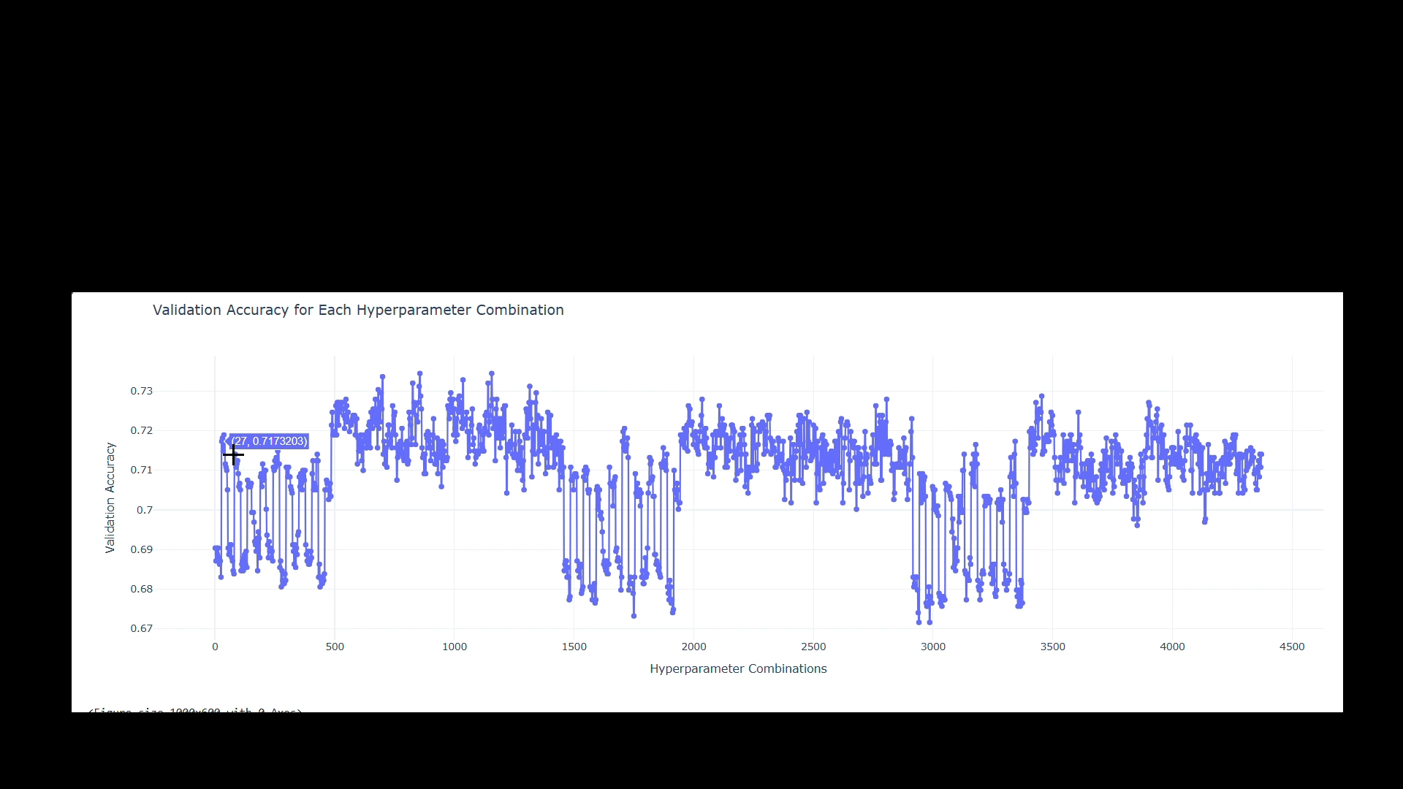
Validation Accuracy for Each Hyperparameter Combination
There are regions where the accuracy is clustered around 0.72-0.73, indicating that some hyperparameter combinations were more effective than others
4
Notes:
The plot displays how validation accuracy varies across different hyperparameter combinations. We see clusters of accuracy around 0.72–0.73, suggesting that some combinations were more effective than others in improving model performance. Notably, there are dips in validation accuracy at specific hyperparameter settings, underscoring the importance of careful tuning to avoid suboptimal configurations. The accuracy range, spanning from approximately 0.67 to 0.73, indicates that the model’s performance is quite sensitive to changes in hyperparameters.

Slide 45
Optimal Parameters
Optimal Parameters for Hyperparameter Tuning
Parameters | n_estimators | 100
 | max_depth | 4
 | learning_rate | 0.1
 | subsample | 0.6
 | colsample_bytree | 0.6
 | min_child_samples | 10
 | reg_alpha | 0
 | reg_lambda | 0.1
4
Notes:
After further exploration, the optimal hyperparameter set yielding the highest accuracy has been identified.

Slide 46
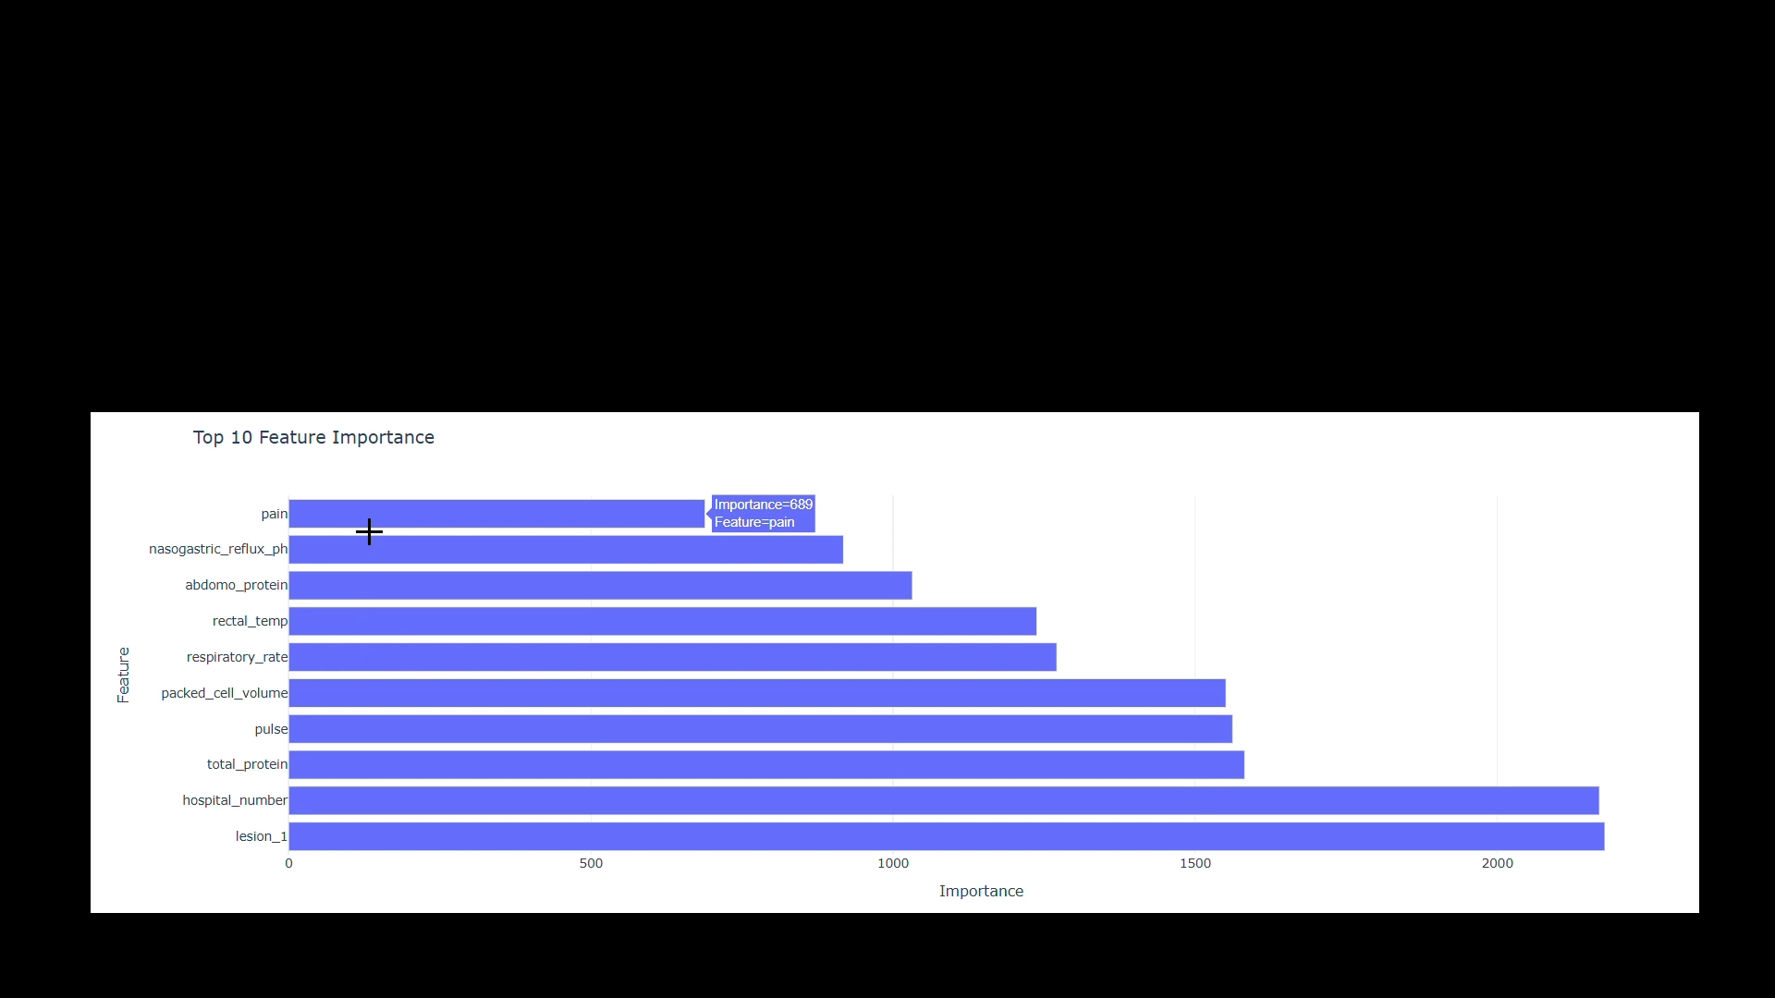
Feature Importance
Lesion_1 and hospital_number are the two most important features
Pain has relatively lower importance compared to the top-ranked features
4
Notes:
Feature importance analysis reveals that Lesion_1 and hospital_number are the two most influential features, offering significant predictive power for the model. In contrast, Pain shows lower importance relative to these top-ranked features. While Pain contributes to predictions, it appears less decisive than other clinical variables. This insight is valuable for understanding which medical factors most impact model predictions, especially in LightGBM, where focusing on high-importance features could potentially enhance the predictive score.

Slide 47
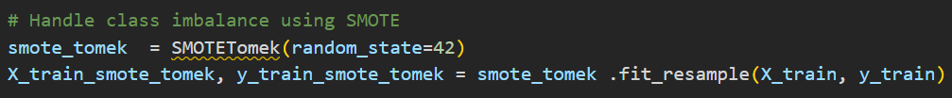
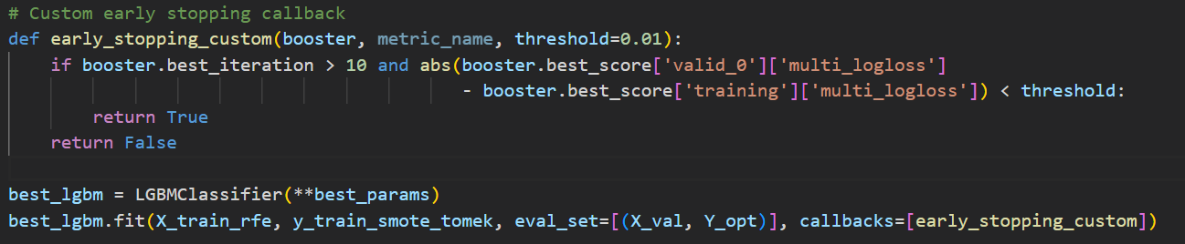
Chosen Solution Novelty
Handling Imbalanced Classes
SMOTE + Tomek Links to remove Tomek links, which are noisy samples.
This reduces bias and improves class separability
Dynamic Feature Selection
Implemented Recursive Feature Elimination with LightGBM to dynamically choose the best features based on importance.
Early Stopping
4
Notes:
To address class imbalance, we opted for a combination of SMOTE and Tomek Links instead of standard SMOTE alone. This approach combines oversampling with dataset cleaning, removing noisy samples (Tomek links) to reduce bias and improve class separability.
For feature selection, rather than using a static approach, we implemented Recursive Feature Elimination (RFE) with LightGBM to dynamically select the most relevant features based on their importance. Leveraging LightGBM’s feature importance metrics, we set a threshold to remove the least important features, reevaluating the model after each iteration to ensure optimal feature selection.
We also customized our early stopping strategy to optimize training efficiency. Rather than using a fixed number of rounds, we implemented a threshold-based stopping criterion. Training stops when either the difference between training and validation loss becomes minimal or validation accuracy fails to improve beyond a specified percentage of boosting rounds. This strategy helps save training time while maintaining model performance.

Slide 48
Comparison of LightGBM and Ensemble Learning
Reasons for Ensemble Underperformance:
Data Characteristics: LightGBM better suited for the dataset with 28 features.
Overfitting: Small dataset (1,235 rows) may cause ensembles to fit noise.
Redundancy of Models: If LightGBM captures key patterns, adding similar models may not help.
Conclusion:
A well-tuned single model can outperform ensembles in specific scenarios.
LightGBM effectively captures relevant patterns, leading to better generalization.
Validation Accuracy | LightGBM (79.94%) > Ensemble (75.20%)
Training Time | LightGBM (150 mins) < Ensemble (180 mins)
4
Notes:
In our comparison, we found that although ensemble learning models typically outperform individual models like XGBoost, CatBoost, and HistBoost, LightGBM achieved a higher validation accuracy of 79.94%. In this specific experiment, the ensemble, which included XGBoost, CatBoost, and HistBoost, did not perform as well.
When it comes to training time, LightGBM was also more efficient, taking only 150 minutes, while ensembles require more time due to the need to train multiple models.
Several factors contributed to the ensemble's inability to outperform LightGBM. First, the characteristics of our dataset may favor LightGBM, which is designed to handle large datasets with many features effectively. Second, with a small dataset of 1,235 rows and 28 features, the ensemble risked overfitting, while a single well-tuned model like LightGBM could generalize better. Lastly, if LightGBM already captures the most critical patterns in the data, adding models that perform similarly can lead to redundancy without significant improvement in predictions.
This experiment highlights that a well-tuned single model can outperform a complex ensemble in certain scenarios, demonstrating that while ensemble methods are valuable, they are not always the best solution.

Slide 49
06
Conclusion

Slide 50
Conclusion
Methodology | Public Score
Random Forest Classifier | 0.78048
LightGBM | 0.84756
HistBoost | 0.77439
XGBoost | 0.78048
CatBoost | 0.75609
Ensemble Learning | 0.79268
4
Notes:
Therefore, LightGBM gave us the highest Public Score ranking at top 6% of the leaderboard

Slide 51
Reflection & Insights
Developed Various Machine Learning Algorithms
Experimental Analysis Insights
01
02
Random Forest
XGBoost
LightGBM
HistGradientBoosting
CatBoost
XGBoost and LightGBM are better in handling complex and high-dimensional data
Random Forest provides valuable interpretability
03
Further Refinements
To mitigate individual model limitations, we applied
Stacking
Feature Engineering
enabling a balanced combination of strengths across models and achieving improved predictive performance.
4
Notes:
In conclusion, we developed a robust predictive model for forecasting horse health outcomes by exploring a range of machine learning algorithms, including Random Forest, XGBoost, LightGBM, HistGradientBoosting, and CatBoost. Each algorithm offered unique strengths: XGBoost and LightGBM excelled in handling complex, high-dimensional data, while Random Forest provided valuable interpretability.
To further enhance accuracy and address individual model limitations, we applied a stacking technique, combining the strengths of each model to achieve improved predictive performance. This project has been an insightful journey, offering a deeper understanding of the trade-offs between model complexity, interpretability, and accuracy. These insights have built a strong foundation for future work in predictive modeling and machine learning applications.

